Slide 1
Deploying microservice over the EKS cluster using Terraform
Contributors
Mohan Hundre
Deeksha Arora
Sonam Jain

Slide 2
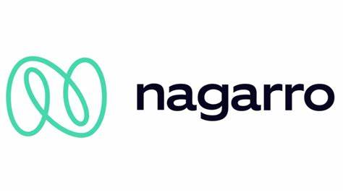

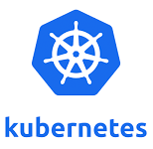
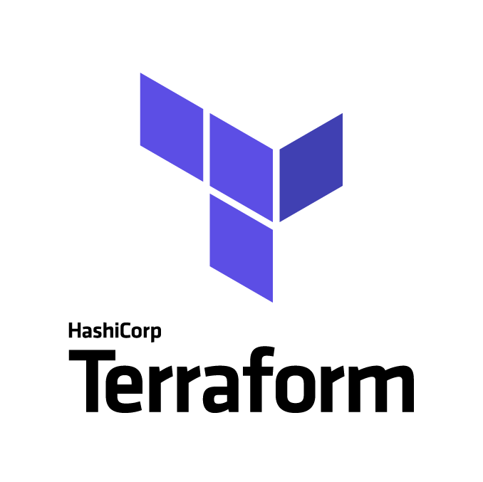
Technologies used for this POC
DevOps tools/ technologies used for this POC
AWS Cloud
Terraform
Kubernetes EKS

Slide 3
Introduction:
Our goal is to create a AWS EKS cluster using Terraform and deploy a microservice on it
Amazon Web Services is a cloud service provider that provides on-demand cloud computing platforms.
Amazon Elastic Kubernetes Service (Amazon EKS) is a managed Kubernetes service that makes it easy for you to run Kubernetes on AWS and on-premises.
Terraform is an open-source Infrastructure-as-code(IaC) software tool created by HashiCorp. It is used to define and provision the complete infrastructure using an easy-to-learn declarative language.

Slide 4
Pre-Requisites:
VS Code
AWS CLI
Terraform
EKS

Slide 5
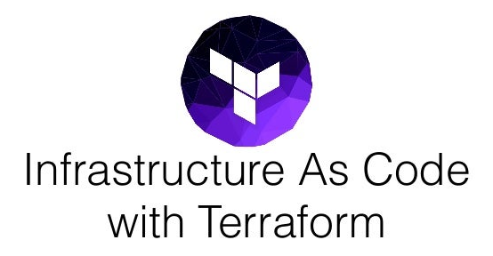
Infrastructure-as-Code(IaC) : Terraform
Terraform is an open-source tool created by HashiCorp that allows you to define your infrastructure as code (IaC) using a simple, declarative language and to deploy and manage that infrastructure across a variety of public cloud providers (e.g., Amazon Web Services, Microsoft Azure, Google Cloud Platform, DigitalOcean) and private cloud and virtualization platforms (e.g., OpenStack, VMWare) using a few commands.
Instead of clicking around a web UI , the idea behind IaC is to write code to define, provision, and manage your infrastructure.
Terraform code is written in a language called HCL in files with the extension .tf. It is a declarative language, so your goal is to describe the infrastructure you want, and Terraform will figure out how to create it.

Slide 6
Benefits of IaC
It has a no. of benefits -
You can automate your entire provisioning and deployment process, which makes it much faster and more reliable than any manual process.
You can represent the state of your infrastructure in source files.
You can store those source files in version control, which means the entire history of your infrastructure is now captured in the commit log, which you can use to debug problems, and if necessary, roll back to older versions.
You can validate each infrastructure change through code reviews and automated tests.
You can create a library of reusable, documented, battle-tested infrastructure code that makes it easier to scale and evolve your infrastructure.

Slide 7
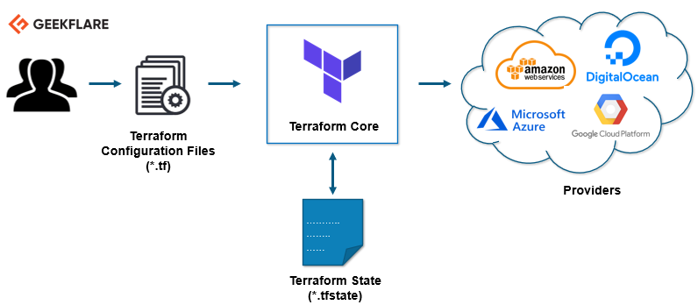
How Terraform works ?
Architecture of Terraform

Slide 8
Terraform Core And Provider
Terraform has two main components that make up its architecture:
Terraform Core
Providers
Terraform Core uses two input sources to do its job.
The first input source is a Terraform configuration that you, as a user, configure. Here, you define what needs to be created or provisioned.
And the second input source is a state where terraform keeps the up-to-date state of how the current set up of the infrastructure looks like.
Provider : The second component of the architecture are providers for specific technologies. This could be cloud providers like AWS, Azure, GCP, or other infrastructure as a service platform.
It gives you the possibility to create infrastructure on different levels.

Slide 9
Providers
Terraform relies on plugins called providers to interact with cloud providers, SaaS providers, and other APIs.
Each provider adds a set of resource types and/or data sources that Terraform can manage.
Every resource type is implemented by a provider; without providers, Terraform can't manage any kind of infrastructure.
For each provider, there are many different kinds of resources you can create, such as servers, databases, and load balancers.
The Terraform Registry is the main directory of publicly available Terraform providers, and hosts providers for most major infrastructure platforms. Each provider has its own release cadence and version numbers.
Sample Provider block -
provider "aws" { region = "us-east-1" }

Slide 10
Terraform basics
General Syntax
The general syntax for a Terraform resource is:
resource "<PROVIDER>_<TYPE>" "<NAME>" { [CONFIG …] }
Where –
Provider is the name of provider eg – AWS
Type is the type of resources to create in that provider eg – instance , vpc etc.
Name is an identifier you can use throughout the Terraform code to refer that resource
Config contains one or more arguments specific to that resource

Slide 11
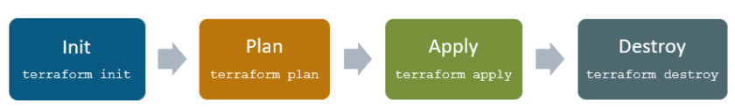
Terraform Lifecycle
Terraform lifecycle consists of – init , plan, apply, and destroy.

Slide 12
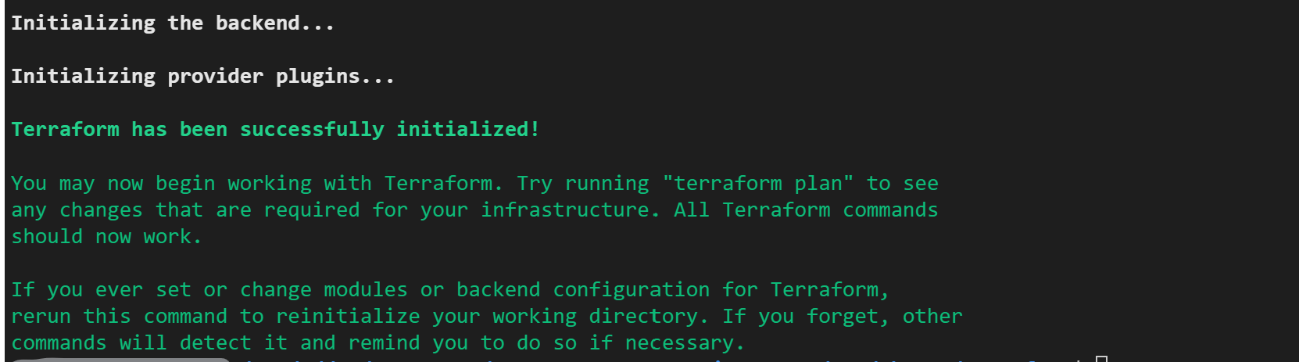
1. Terraform init
Terraform init initializes the working directory which consists of all the configuration files.
The terraform binary contains the basic functionality for Terraform, but it does not come with the code for any of the providers (e.g., the AWS provider, Azure provider, GCP provider, etc), so when first starting to use Terraform, you need to run terraform init to tell Terraform to scan the code, figure out what providers you’re using, and download the code for them.

Slide 13
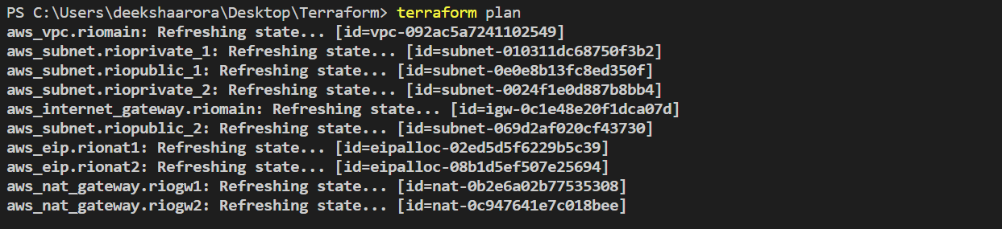
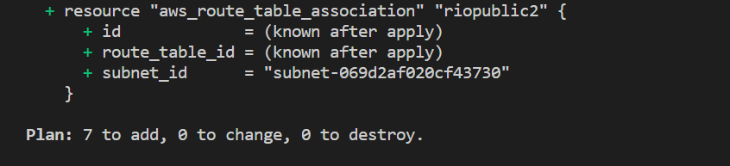
2. Terraform plan
Terraform plan is used to create an execution plan to reach a desired state of the infrastructure. Changes in the configuration files are done in order to achieve the desired state.
The plan command lets you see what Terraform will do before actually doing it.
The output of the plan command is a little like - resources with a plus sign (+) are going to be created, resources with a minus sign (-) are going to be deleted, and resources with a tilde sign (~) are going to be modified in-place.

Slide 14
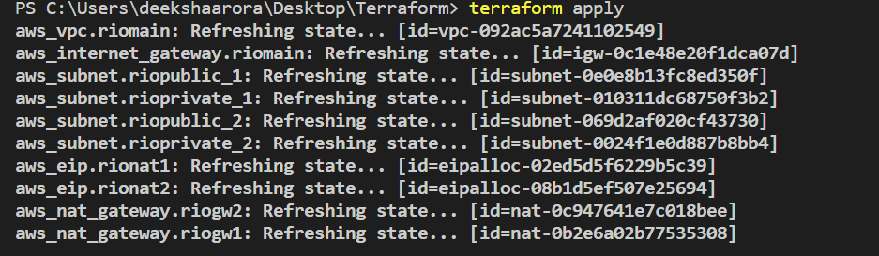
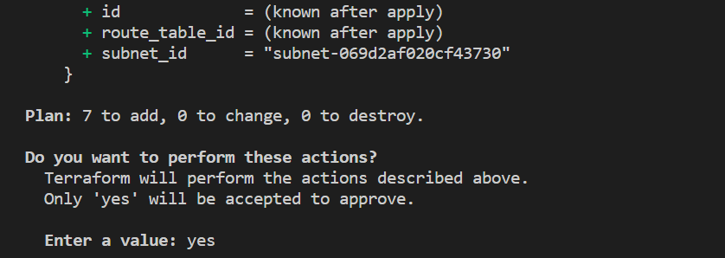
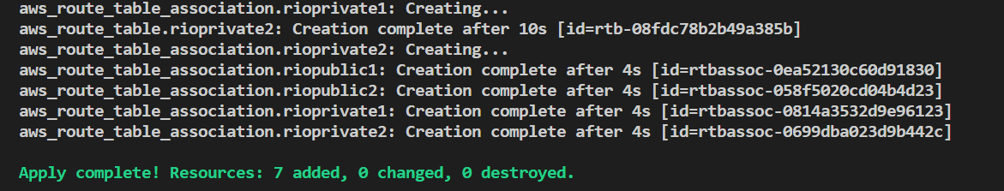
3. Terraform apply
Terraform apply then makes the changes in the infrastructure as defined in the plan, and the infrastructure comes to the desired state.
The apply command shows you the same plan output and asks you to confirm if you actually want to proceed with this plan. So, while plan is available as a separate command, it’s mainly useful for quick sanity checks and during code reviews, and most of the time you’ll run apply directly and review the plan output it shows you.

Slide 15
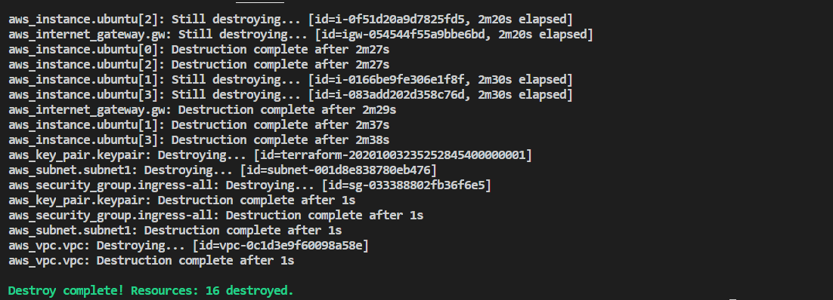
4. Terraform destroy
Terraform destroy is used to delete all the old infrastructure resources, which are marked tainted after the apply phase.
When you’re done with your tasks , it’s a good idea to remove all the resources you created so AWS doesn’t charge you for them. Since Terraform keeps track of what resources you created, cleanup is simple. All you need to do is run the terraform destroy command and clean up is done itself.

Slide 16
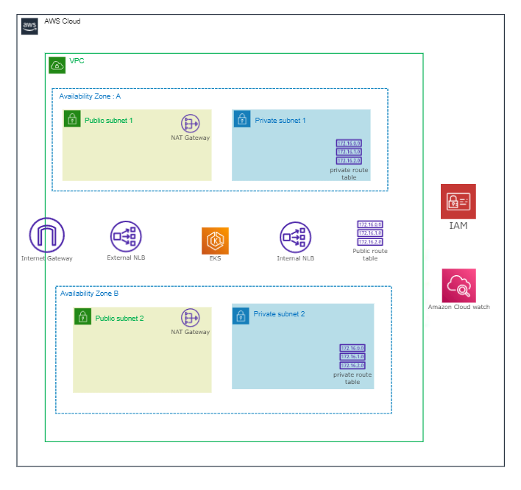
POC Solution Design Architecture
Components – 1. VPC 2. Internet Gateway
3. Private and Public Subnets
4. NAT Gateways
5. Route Tables
6. EKS cluster and worker nodes
7. Load balancer

Slide 17
AWS Terminology : VPC and its Components

Slide 18
VPC - Virtual private cloud
A VPC is a virtual network that closely resembles a traditional network that you'd operate in your own data center.
It provides a logically isolated area of the AWS cloud where you can launch AWS resources in a virtual network that you define.
You have complete control over your virtual networking environment, including a selection of your IP address range, the creation of subnets, and configuration of route tables and network gateways.
Sample VPC block -
resource "aws_vpc" "main" {
cidr_block = "10.0.0.0/16"
instance_tenancy = "default"
tags = {
Name = "main"
}
}

Slide 19
Subnets
A subnet is a range of IP addresses in your VPC. A subnet must reside in a single Availability Zone.
After you add subnets, you can deploy AWS resources in your VPC.
Public subnet: The subnet has a direct route to an internet gateway. Resources in a public subnet can access the public internet.
Private subnet: The subnet does not have a direct route to an internet gateway. Resources in a private subnet require a NAT device to access the public internet.
Basic Subnet block -
resource "aws_subnet" “main" {
vpc_id = aws_vpc.main.id
cidr_block = "10.0.1.0/24"
tags = {
Name = "Main"
}
}

Slide 20
Internet Gateway
You need an Internet gateway so that your instances can communicate with the Internet. If you don’t have an Internet gateway, your instances will not be able to communicate with the outside world i.e it acts as a router that connects your VPC to the Internet.
An Internet gateway enables resources in your public subnets (such as EC2 instances) to connect to the Internet if the resource has a public IPv4 address or an IPv6 address.
Sample Internet Gateway block -
resource "aws_internet_gateway" "gw" {
vpc_id = aws_vpc.main.id
tags = {
Name = "main"
}
}

Slide 21
NAT Gateway
A NAT gateway is a Network Address Translation (NAT) service. You can use a NAT gateway so that instances in a private subnet can connect to services outside your VPC but external services cannot initiate a connection with those instances.
It enables instances in private subnets to communicate with resources on the Internet without using public IP addresses.
Elastic ips are created and associated with the NAT Gateways( in public subnets) , where explicit dependency on Internet Gateway are specified.
Sample NAT Gateway block -
resource "aws_nat_gateway" "example" {
allocation_id = aws_eip.example.id
subnet_id = aws_subnet.example.id
tags = {
Name = "gw NAT"
}
# To ensure proper ordering, it is recommended to add an explicit dependency
# on the Internet Gateway for the VPC.
depends_on = [aws_internet_gateway.example]
}

Slide 22
Route Tables
A route table contains a set of rules, called routes, that determine where network traffic from your subnet or gateway is directed.
For specifying NAT Gateway id , use nat_gateway_id instead of gateway_id
Sample Route table block -
resource "aws_route_table" "example" {
vpc_id = aws_vpc.example.id
route {
cidr_block = "10.0.1.0/24"
gateway_id = aws_internet_gateway.example.id
}
tags = {
Name = "example"
}
}

Slide 23
Route table association
You need to create a route table association to link a subnet to the appropriate route table.
We add NAT Gateways to the public subnets and create route table and route table associations , which associates private subnets to the NAT Gateways.
Furthermore, public subnets are associated to the Internet Gateway , through route table and route table associations.
Sample Route table association block -
resource "aws_route_table_association" "a" {
subnet_id = aws_subnet.foo.id
route_table_id = aws_route_table.bar.id
}

Slide 24
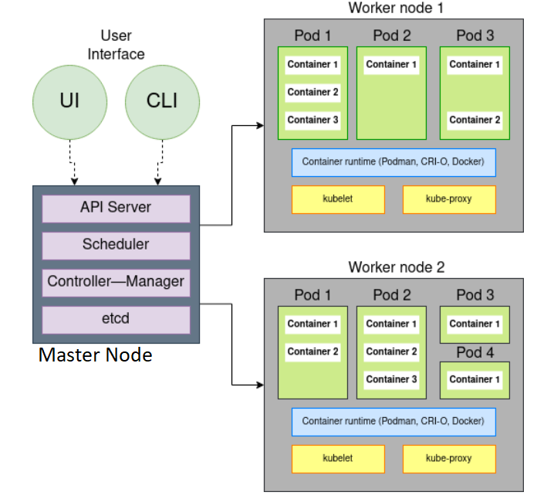
Kubernetes working - Architecture

Slide 25
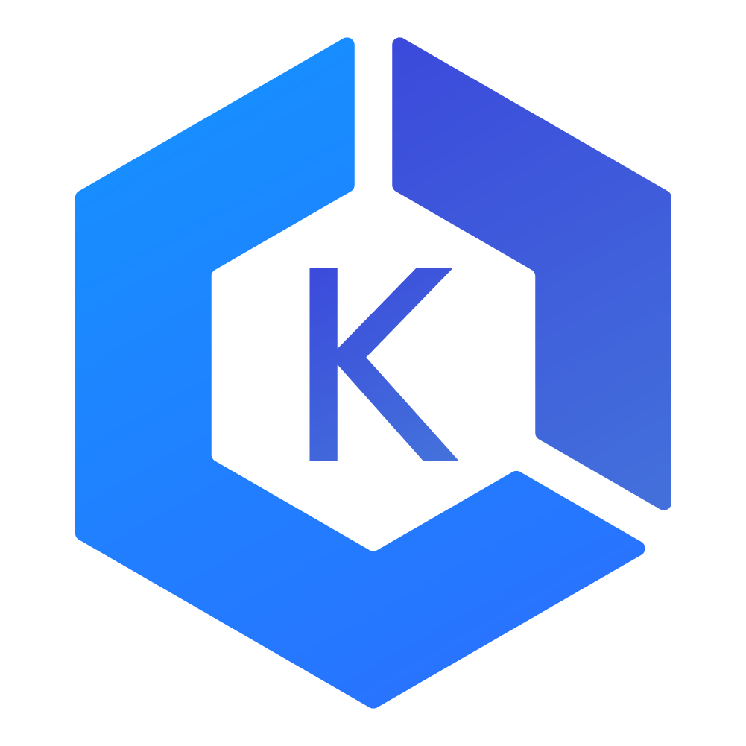
EKS cluster
We have created aws_iam_role , so that Amazon EKS can use it , to create AWS resources for Kubernetes cluster.
Next, we created aws_iam_role_policy_attachment to attach Amazon EKS cluster policy to this role.
Then, we created a EKS cluster and provided name , role as the arguments to it. Specified the subnets too as argument and at last, explicitly defined the policy as dependency , so that , EKS cluster is created after the external dependencies are met.

Slide 26
EKS node-group ( Worker Nodes )
Firstly , we created a aws_iam_role , to grant permission to ec2 service to create AWS resources for the Kubernetes worker nodes.
Then, we created a aws_iam_role_policy_attachment , to attach Amazon EKS Worker Node Policy , Amazon EKS CNI Policy General and Amazon EC2 Container Registry Read Only Policy to the role.
Then, we created EKS nodegroup and provided cluster name , nodegroup name and role as the arguments to it. We will also provide subnets as the parameter. NOTE – We provided only the private subnets as argument , because, we are deploying our worker nodes in the private subnet.
We will provide the scaling configuration , ami associated with the nodegroup , instance type in the terraform resource body itself. The explicit dependency on the policies is also specified , so that , worker nodes are created after the external dependencies are met.
Kubernetes version for the worker nodes , will be inherited from the parent cluster itself.

Slide 27
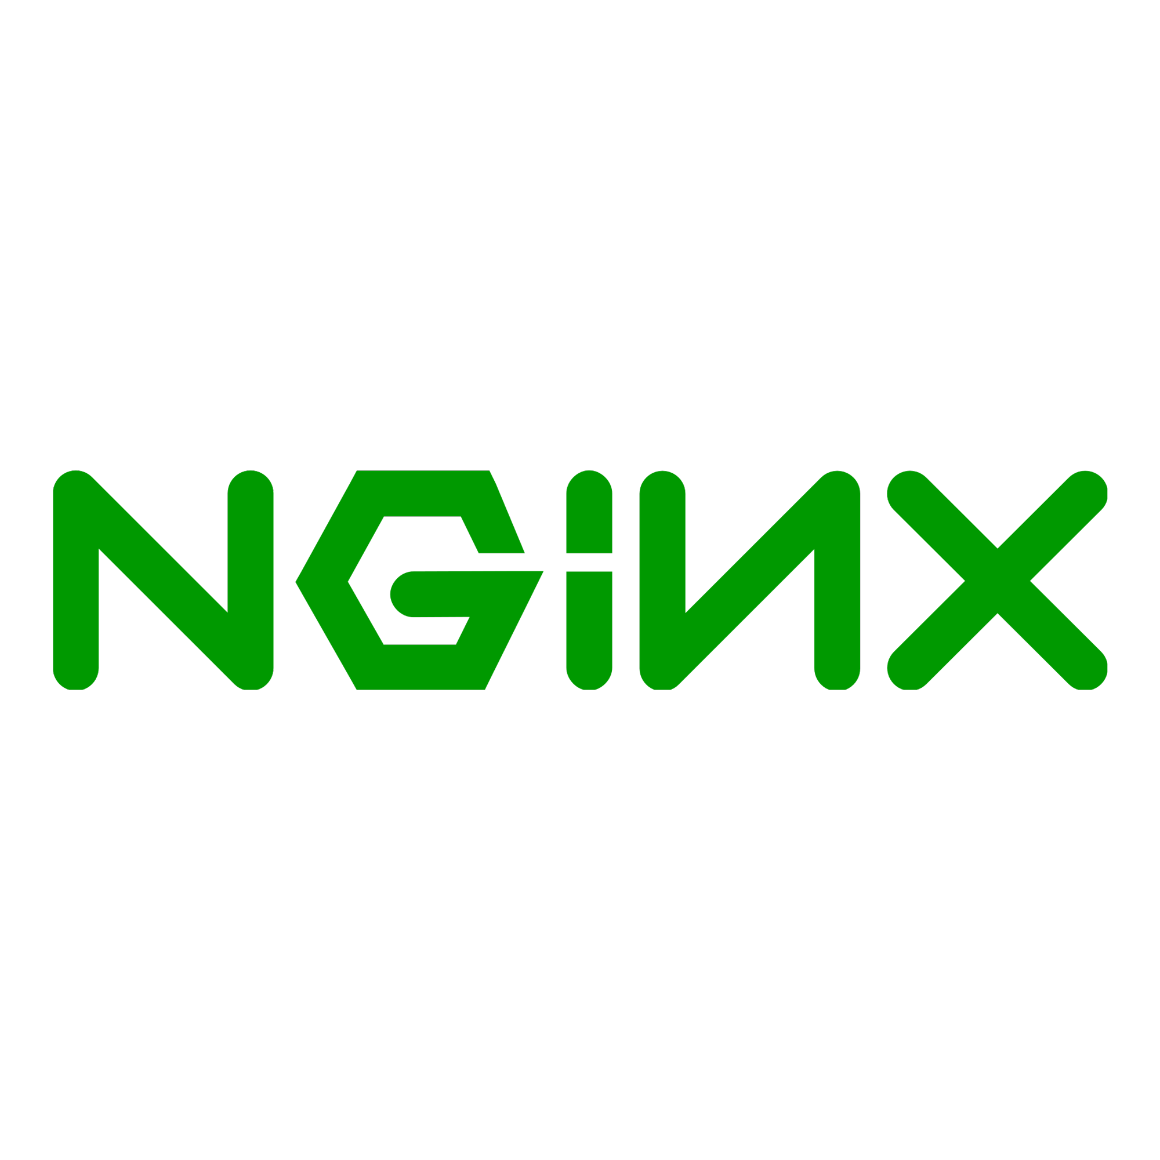
Kubernetes Deployment and Services
We have created a YAML file for deployment and Kubernetes services , for the microservice deployment to the cluster.
Kubernetes deployment specifies the configuration for deployment object. It creates a pod and each pod , runs specific container , which are defined in the spec. The image which will run inside the container is of nginx.
A service is a way of exposing an application running on a set of pods as a network service. We have created internal and external load balancers as services. We have defined a selector that has app: nginx label , using which , service will be able to match and identify the pods in our nginx deployment and the pods also have same label for identification.
So, all incoming requests to the services will be automatically routed to the nginx deployment.

Slide 28
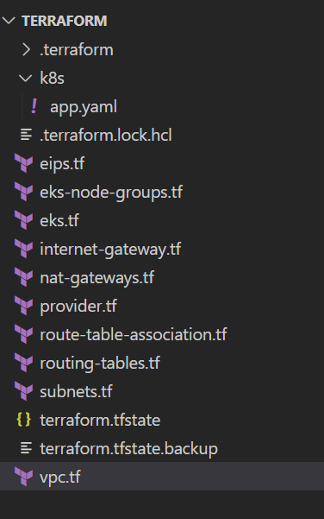
Snapshot of our Code’s directory structure in VS Code

Slide 29

Accessing Kubernetes cluster
Using aws eks command to generate kubeconfig to access our cluster
Verifying the access to cluster

Slide 30
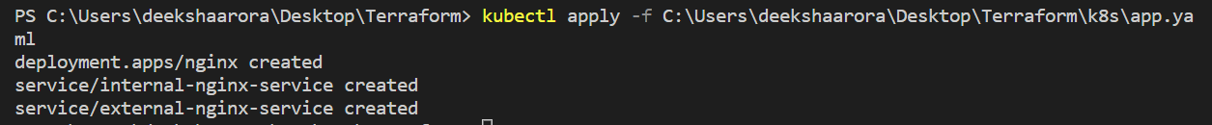

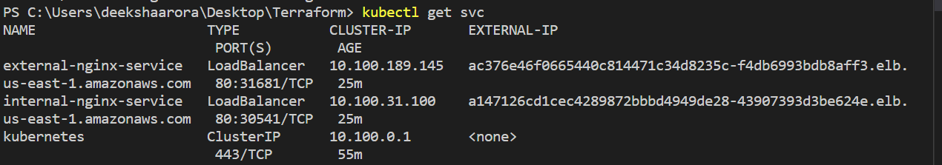
After Kubernetes Deployment
Using kubectl apply command
Pod ready after deployment
Services ready with external ips

Slide 31
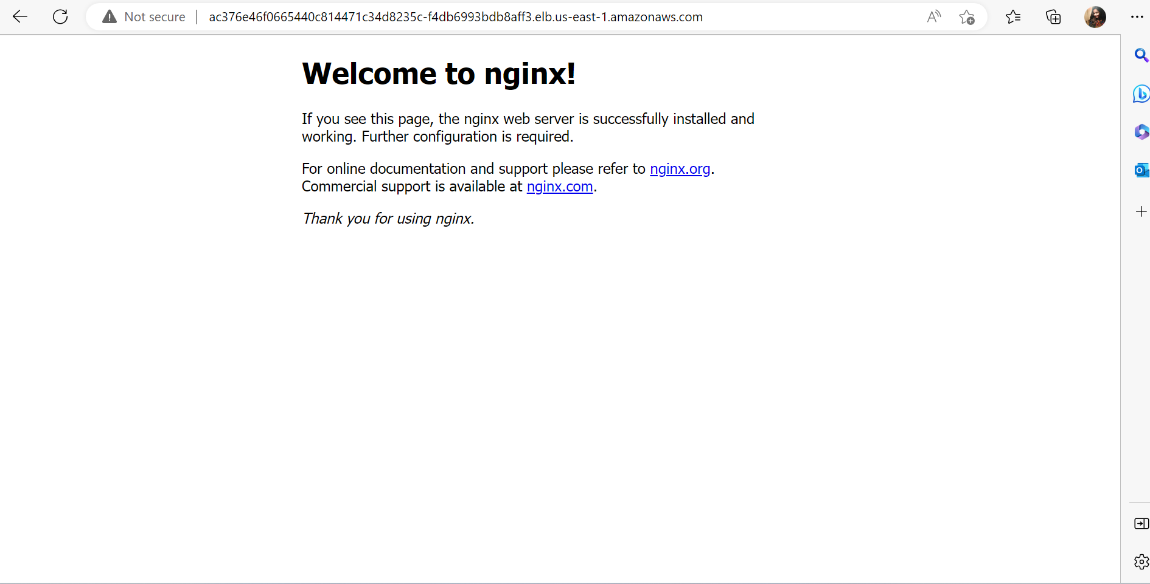
OUTPUT

Slide 32
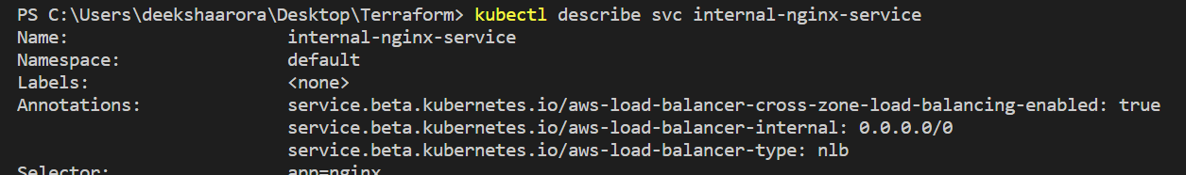
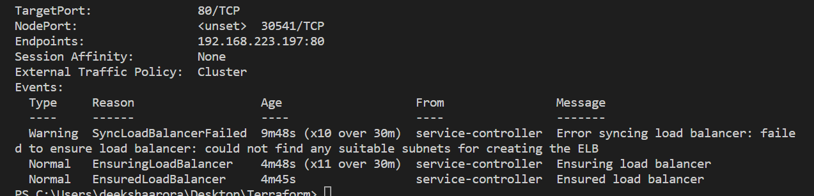
Troubleshooting
ERROR – EKS was not able to discover subnets to deploy load balancers , because of absence of certain mandatory tags in the terraform subnet blocks
Detection of error using kubectl describe svc command

Slide 33
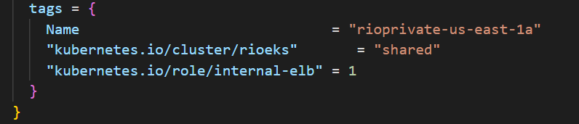
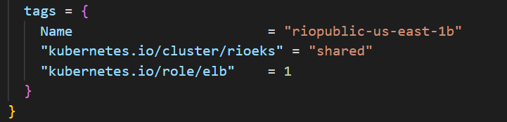
SOLUTION – We included certain mandatory tags in each Terraform subnet resource blocks , so that EKS can discover appropriate subnets to deploy , external and internal load balancers.
For private subnets
For public subnets

Slide 34

DO YOU HAVE ANY QUESTIONS ?

Slide 35
Thank You

